Slide 1
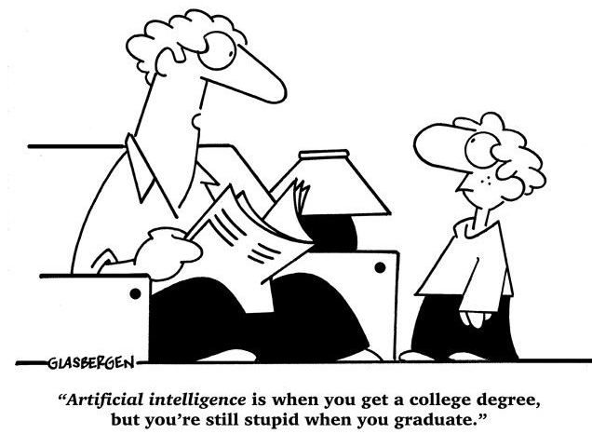
The past and present of AI
汤斯亮（Siliang Tang）
siliang@zju.edu.cn

Slide 2
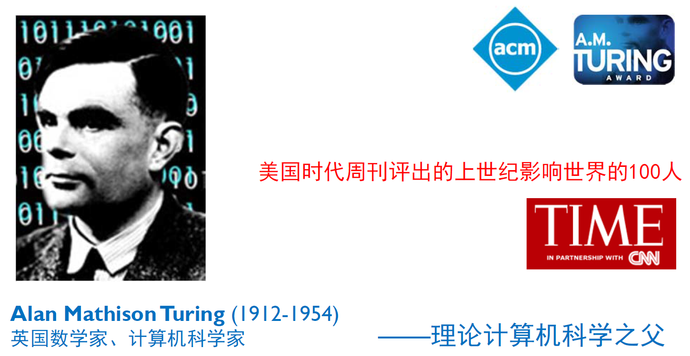
Introduction

Slide 3
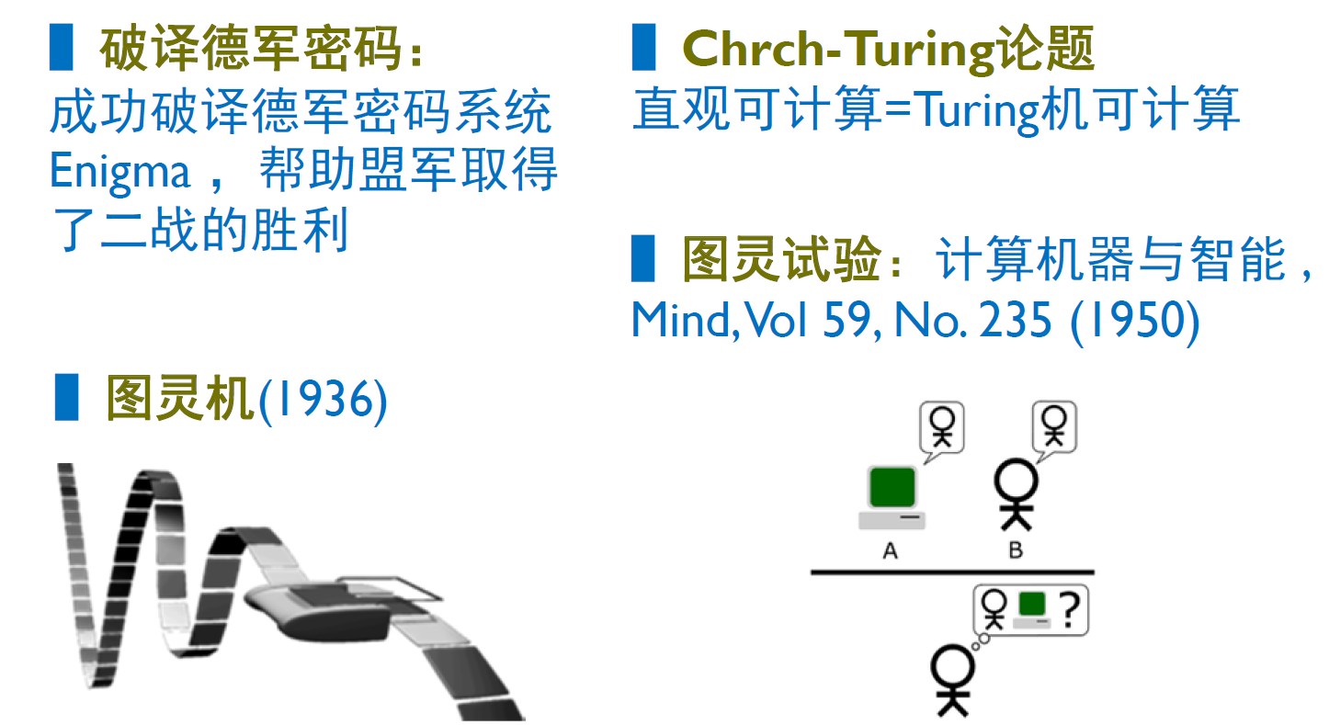

Alan Turing – the father of AI

Slide 4

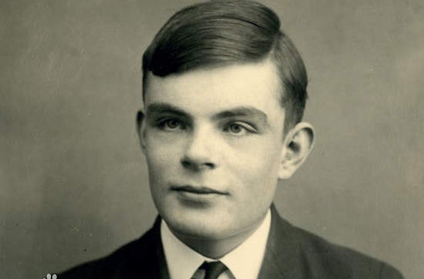
Alan Turing – the father of AI
？

Slide 5
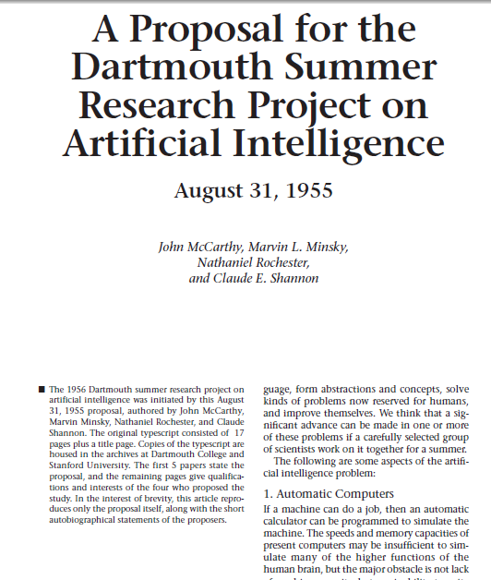
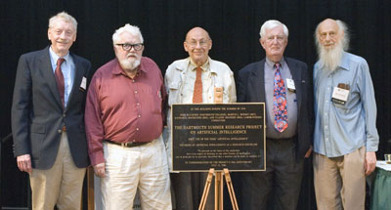
The birth of AI
In 1956, several scholars first established the concept of “artificial intelligence” at Dartmouth College in the US
Professor J. McCarthy at Stanford University (时任Dartmouth数学系助理教授，1971年度图灵奖获得者)
Professor M. L. Minsky at the Massachusetts Institute of Technology (时任哈佛大学数学系和神经学系Junior Fellow，1969年度图灵奖获得)
C. E. Shannon (also known as “the father of information theory”) at Bell Labs
N. Rochester at IBM (第一代通用计算机701主设计师)
Their definition of AI referred to the ability of machines to understand, think, and learn in a similar way to human beings, indicating the possibility of using computers to simulate human intelligence.
Research Project on AI,
August 31, 1955, Dartmouth
AI概念提出50年后，建议人合影

Slide 6
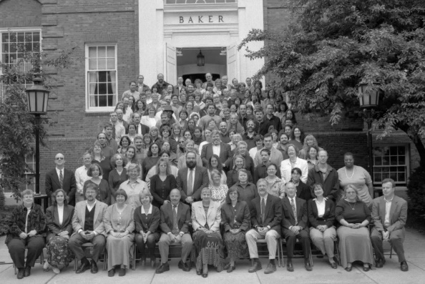
The birth of AI
报告列举了Artificial Intelligence所面临七类问题
Automatic Computers
How Can a Computer be Programmed to Use a Language
Neuron Nets
set of (hypothetical) neurons be arranged so as to form concepts
Theory of the Size of a Calculation
Self-improvement (自我学习与提高)
Abstractions
forming abstractions from sensory
Randomness and Creativity
The randomness must be guided by intuition to be efficient
达特茅斯会议合影 (1956年)

Slide 7
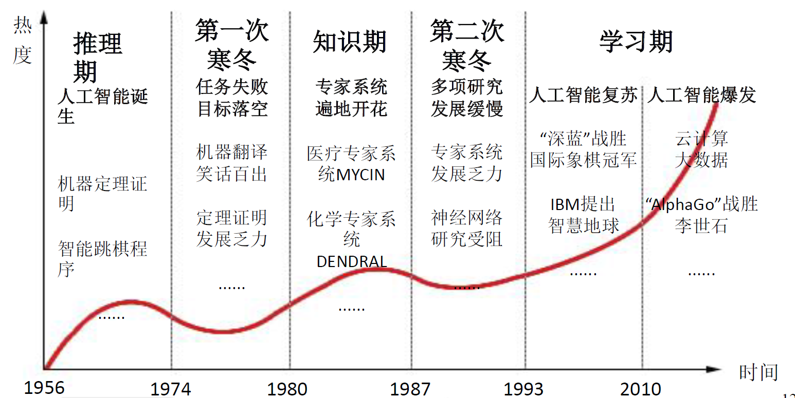
Three setbacks to AI development
AI的三次低谷
1973, The 1st setback - James Lighthill report
1982, The 2nd setback - fifth-generation computer
1984, The 3rd setback - Cyc

Slide 8
External forces promoting the AI 2.0
First, the information environment in the 21st century has changed greatly
along with the popularity of mobile terminals, the Internet, sensor networks, vehicular networking, and wearable devices.
Sensing devices are extensively distributed throughout cities, and the unprecedented rapid expansion of networks connecting individuals and groups throughout the world continues to reflect and aggregate demands, knowledge, and capabilities.
the world has evolved from a binary space (physics and human society, or PH) to a ternary space (cyber, physics, and human society, or CPH). CPH interactions form new computing paradigms, including perception fusion, “man-in-the-loop,” augmented reality, and cross-media computing.

Slide 9
External forces promoting the AI 2.0
Second, social demands for AI are rapidly expanding
AI research is shifting from being driven by academic curiosity to being driven by demands that are focused outside of academia.
The new goals and problems in intelligent cities, medicine, transportation, logistics, manufacturing, and smart products, as well as driverless automobiles and smartphones, all require AI development. Therefore, many enterprises have actively promoted new AI research.

Slide 10
External forces promoting the AI 2.0
Third, the goals of AI have undergone great changes
transforming from the pursuit of “using a computer to simulate human intelligence” to:
enhanced hybrid intelligence systems combining machines and humans;
new crowd intelligence systems organized by machines, humans, and networks;
more complex intelligence systems, such as intelligent cities combining humans, societies, physics, and cyber systems.

Slide 11
External forces promoting the AI 2.0
Fourth, data resources related to AI are changing
AI relies upon data-driven algorithms, and gives rise to a new information environment. These calculations will be driven by the increasing amount of big data, sensors and networks, and cross-media information.
Therefore, the development of AI related to big data, sensors and networks, and cross-media, with a perceptive and fused intelligence, is an inevitable trend. However, the traditional approach of the Turing test for machine intelligence based on symbols will be challenged.
These environmental changes will promote significant advancements in AI technology.

Slide 12
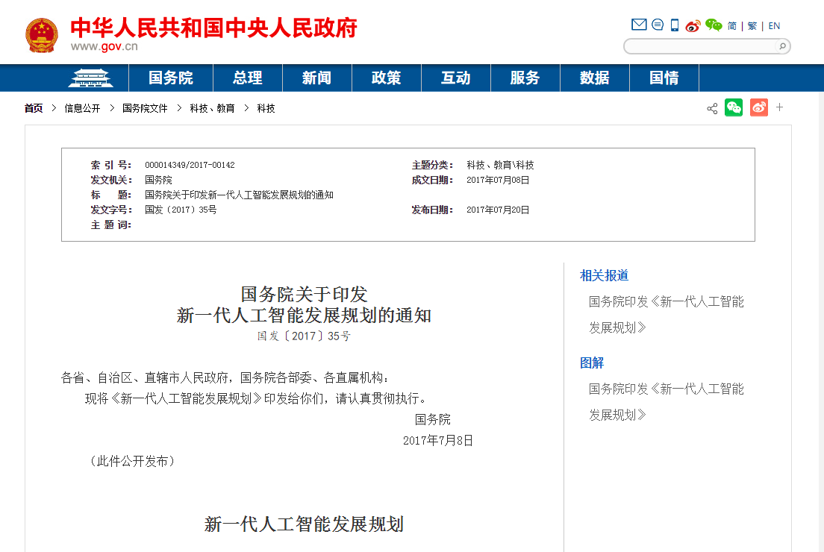
Developing AI 2.0

Slide 13
Developing AI 2.0
Suggested research directions for AI 2.0
Big-data-based intelligence
Internet crowd intelligence
Cross-media intelligence
Human-machine hybrid-augmented intelligence
Autonomous-intelligence systems

Slide 14
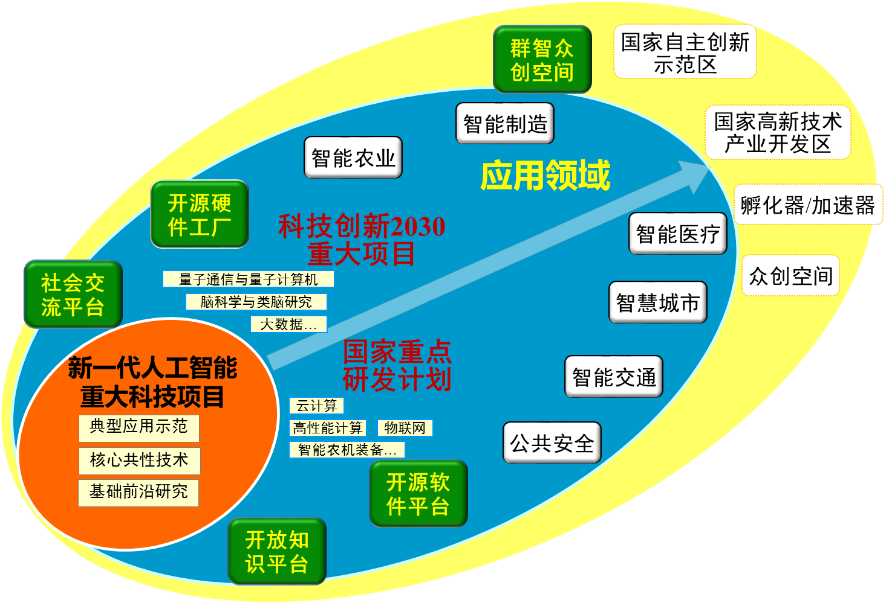
Developing AI 2.0

Slide 15
Recent Advances in AI
Is Turing test for machine intelligence still holds?

Slide 16
Is Turing test for machine intelligence still holds?
听
说
看
写
计算机能听懂人话吗？——语音识别
计算机能阅读并和美女愉快地聊天吗？——智能问答
计算机能看懂图像并且理解电影吗？——语义理解
计算机能创作文字、图像或者进行艺术设计吗？——内容创作
计算机可以下棋、打游戏吗？
计算机可以帮人类看病吗？
计算机可以考上浙江大学吗？
……
复杂推理与决策

Slide 17
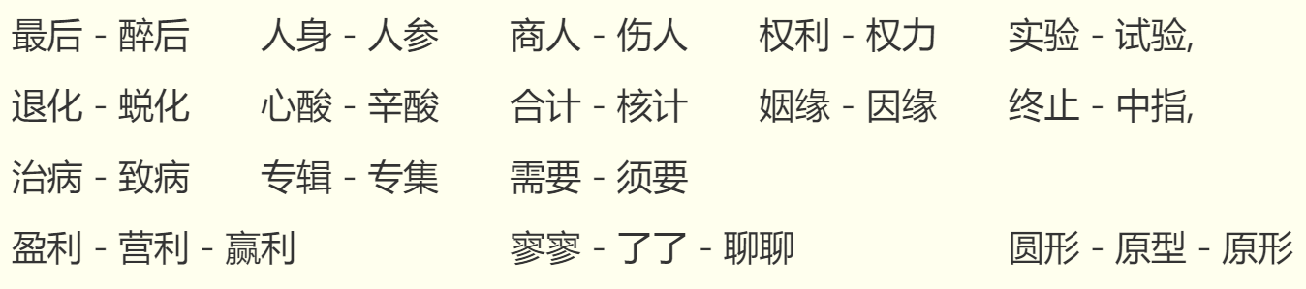
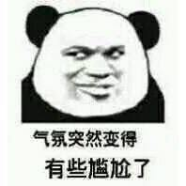
Hearing
Can AI understand voices?
Voice Recognition
口音的多样性——比如“浙普”
同音多义词
小明要去医院治病。
睡眠不好会致病。
小明要去医院致病。
睡眠不好会治病。
借助上下文的理解来保证语音识别结果的正确性

Slide 18
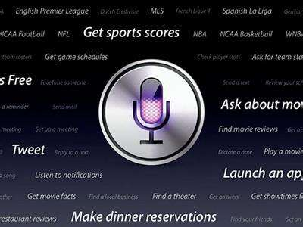
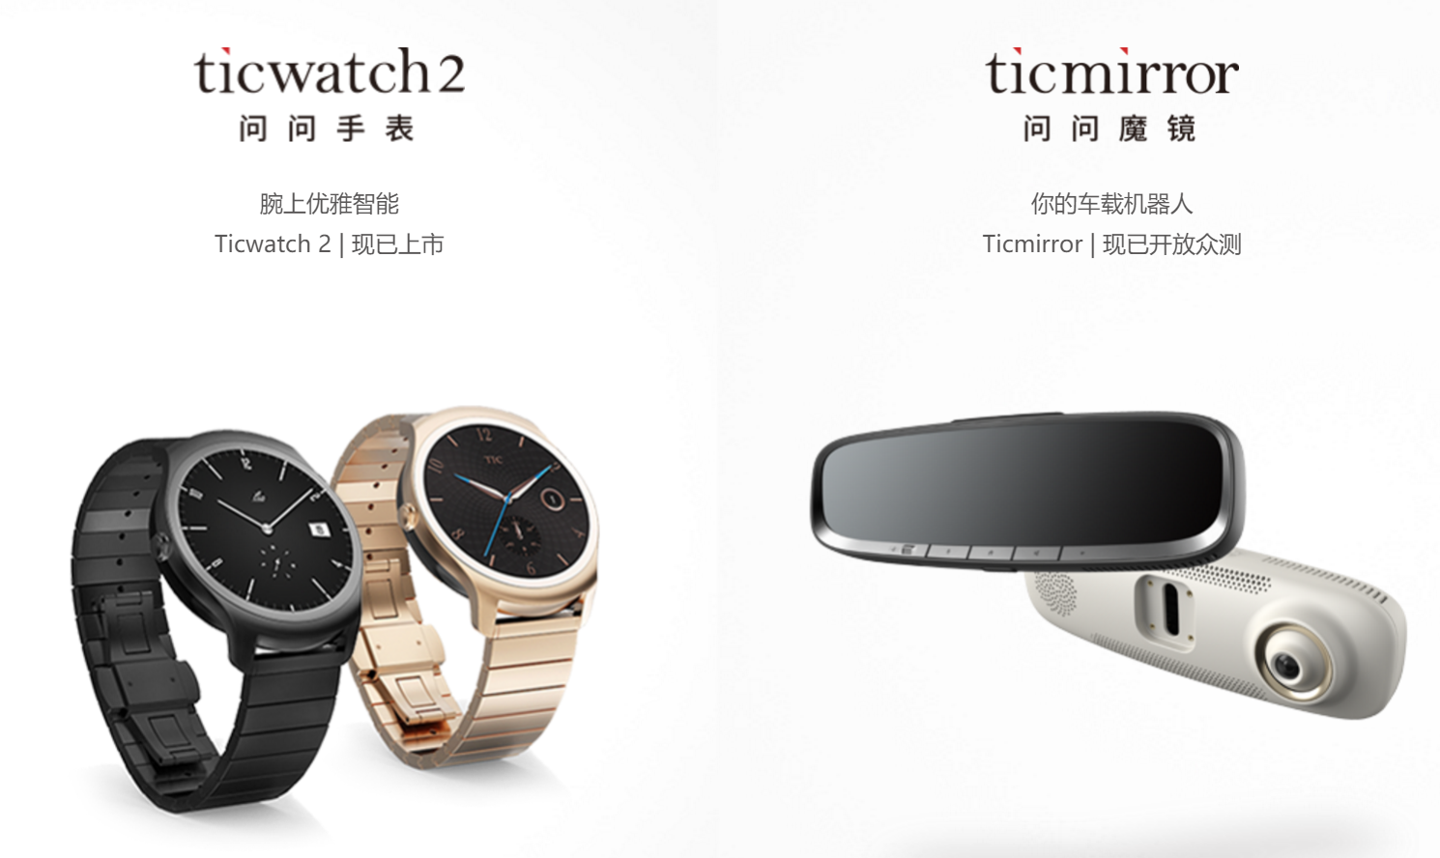
Hearing
Some commercial products

Slide 19
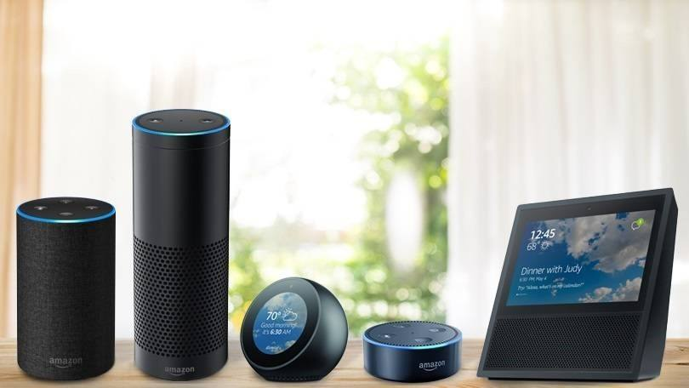
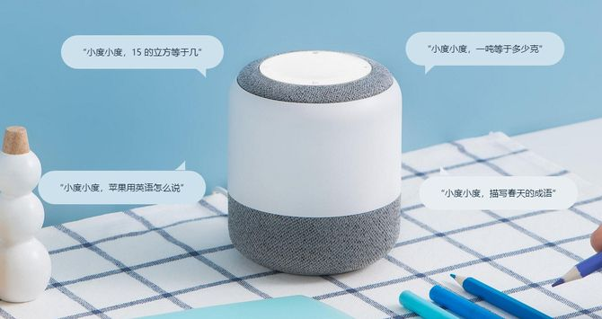
Hearing
Intelligent speakers
Alexa
小度

Slide 20
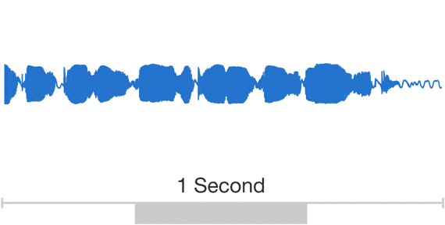

Speaking
Can AI speak?
Speech synthesis
wavenet
https://deepmind.com/blog/wavenet-generative-model-raw-audio/

Slide 21
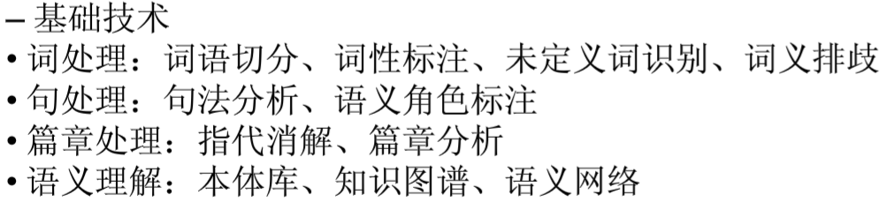
Language Understanding
Can AI understand languages?
计算机智能问答/聊天：自然语言处理技术——Natural Language Processing（NLP）
自然语言：指人类使用的语言，如汉语、英语等
人类历史上以语言文字记形式记载和流传的知识占知识总量的80%以上

Slide 22
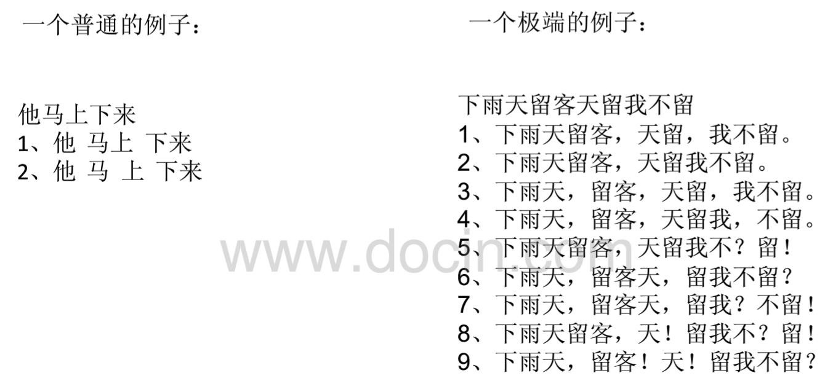
Language Understanding
自然语言处理的难点是什么？
无法象处理人工语言那样，写出一个完备的、有限的规则系统来进行定义和描述，自然语言的规则很少没有意外
自然语言中有大量的歧义现象

Slide 23
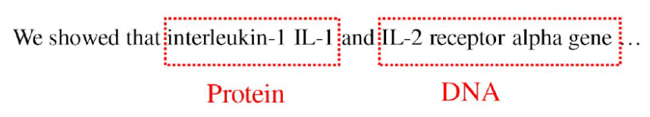
Language Understanding
自然语言处理的难点是什么？
自然语言的理解不仅和语言本身的规律有关，还和语言之外的知识（例如常识）有关，语言理解产生歧义本质上是知识缺乏的表现
我们需要构建一个庞大的知识库来支持自然语言的理解与消歧
手工构建与维护困难
计算机自动学习
Tiger wins second US Open title!

Slide 24

Language Understanding
自然语言处理的难点是什么？
同样的语义有不同形式的表达
问题1：
高考报名需要提交什么材料？
高考报名要交什么？
高考报名要准备什么资料？
高考报名需要哪些东西？
高考报名……?
问题2：
高考志愿怎么填？
高考志愿怎么报？
高考志愿如何填报？
高考志愿怎么搞？
高考志愿……?

Slide 25
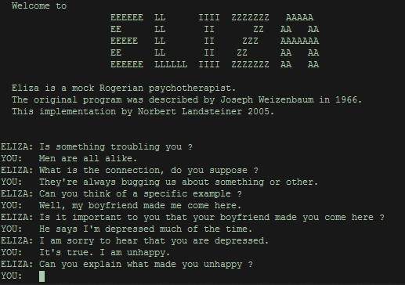
Conversation
Joseph Weizenbaum’s ELIZA (1966)
ELIZA: What is bothering you?
User: I feel sad all the time
ELIZA: Why do you feel sad all the time?
User: I don’t get along with my parents.
ELIZA: Tell me about your parents.
https://en.wikipedia.org/wiki/ELIZA

Slide 26
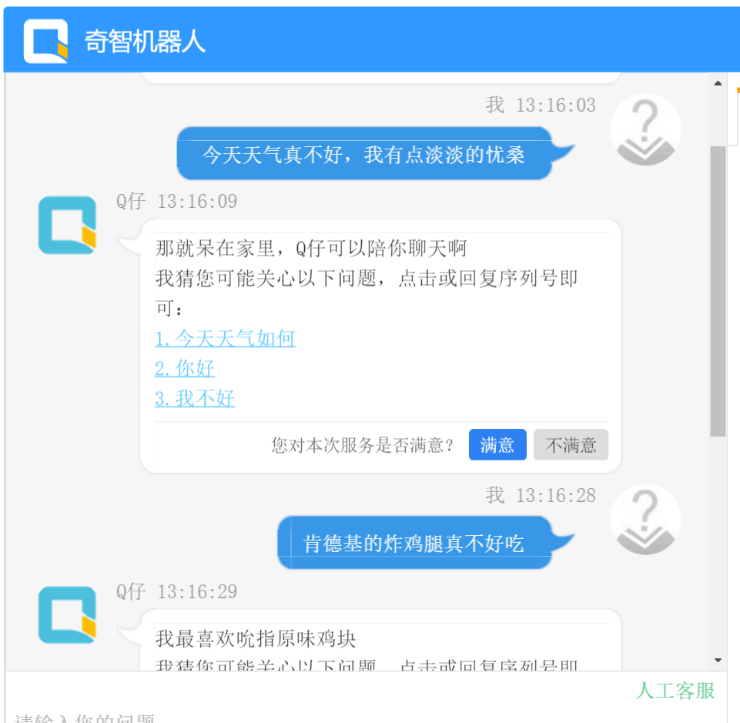
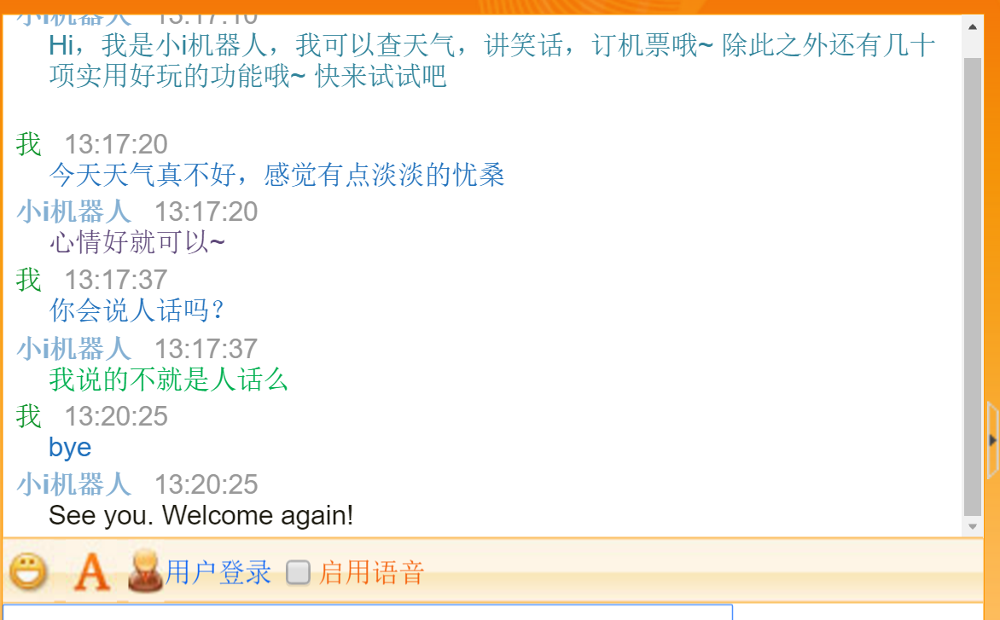
Conversation
Dialogs
计算机能和美女愉快地聊天吗？

Slide 27
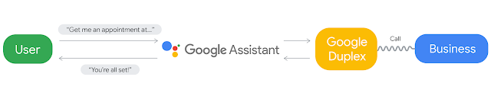
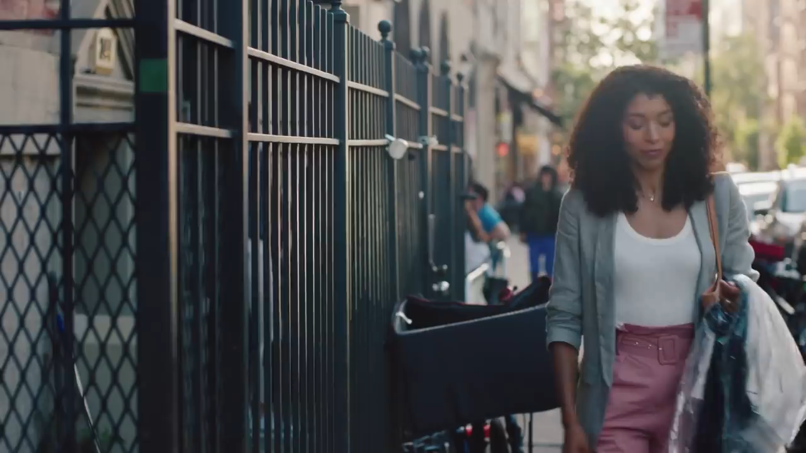
Conversation
Google Duplex
Now, you can use it on all Pixel phones in 43 U.S. states.
https://ai.googleblog.com/2018/05/duplex-ai-system-for-natural-conversation.html

Slide 28
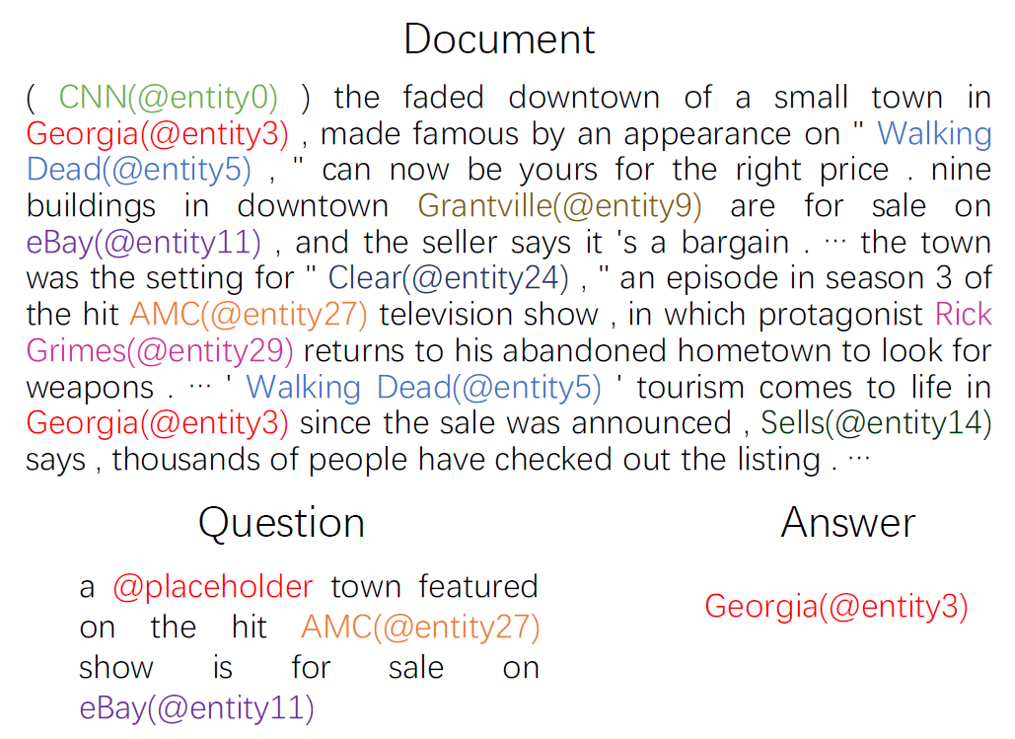
Reading
Machine Reading Comprehension

Slide 29
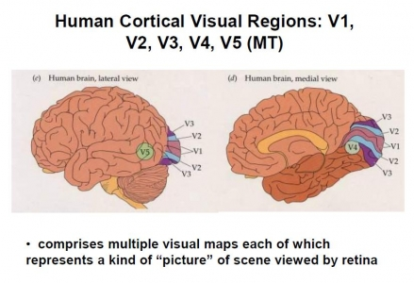
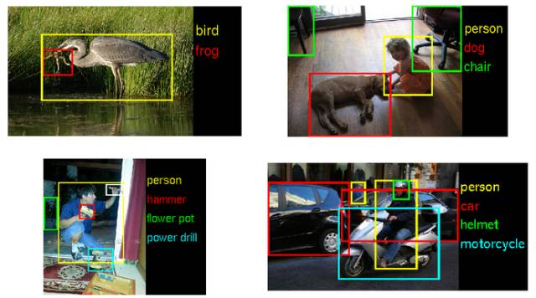
Vision Understanding
计算机视觉技术正在向人类发起挑战
在包含约120万张训练图像、5万张验证图像和10万张测试图像，分为1000个不同类别的“ImageNe1000挑战”中，微软研究团队开发的系统成功将辨识错误率降低至4.94%，首次低于人眼约5.1%的辨识错误率。

Slide 30
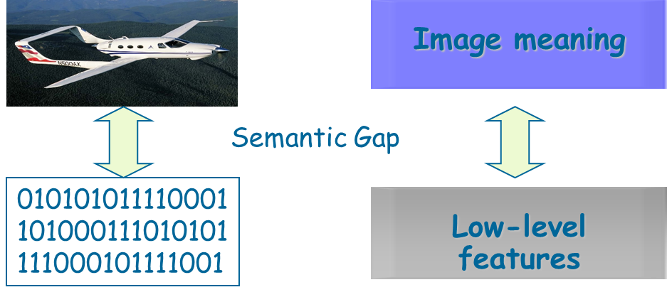
Image Understanding
Challenge – Semantic Gap

Slide 31
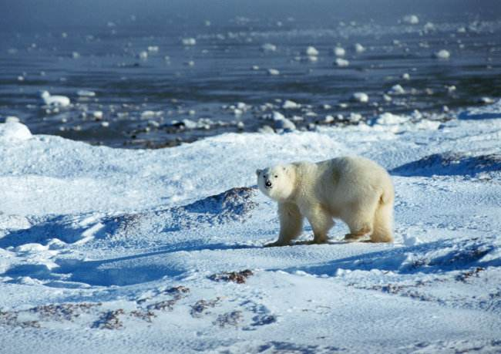
Image Understanding
Challenge——一图胜千言：图像语义的多样性
北极熊
冰原
北极
南极？

Slide 32
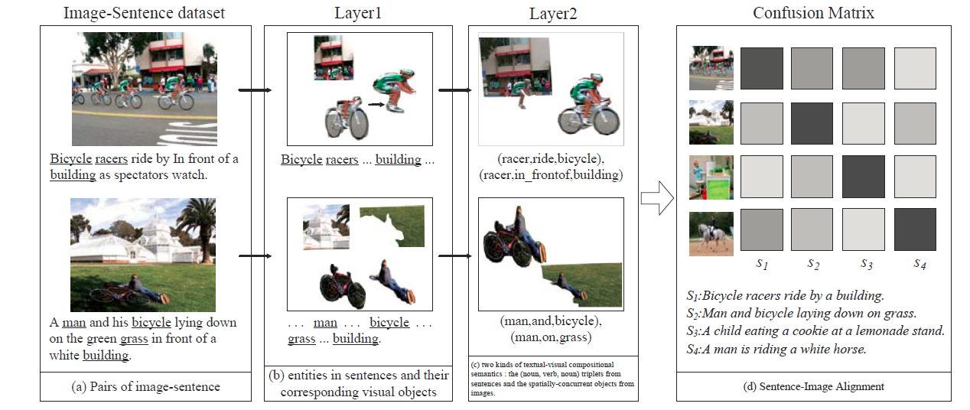
Image Understanding
对图像-句子等耦合数据生成组合语义，在层次化深度学习框架下实现“看图说话”

Slide 33
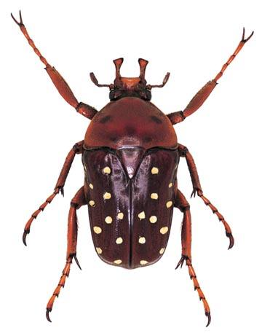
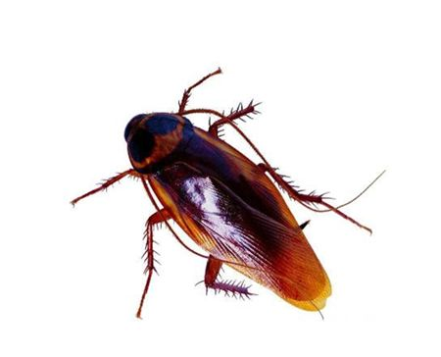
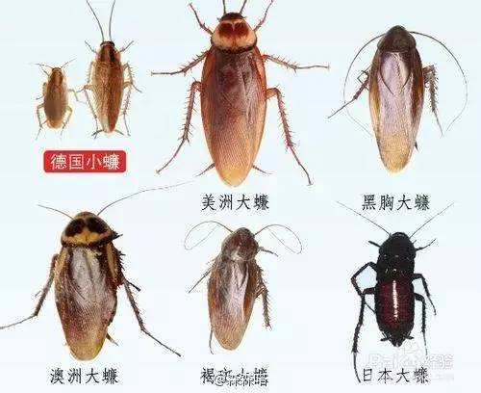
Image Understanding
Fine-grained visual concept recognition

Slide 34
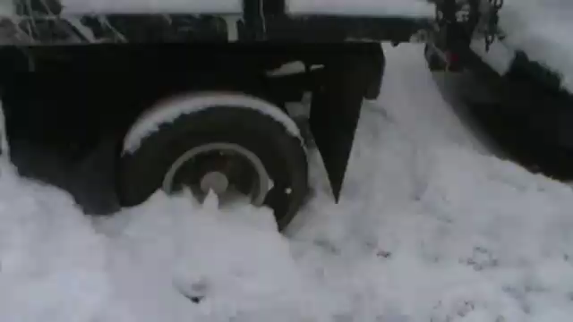
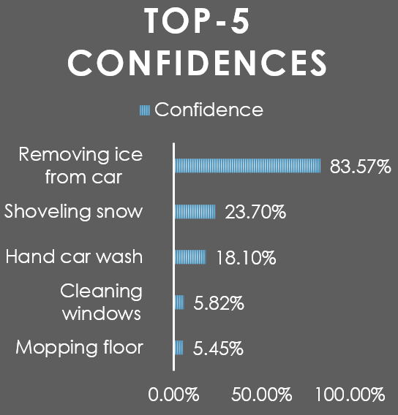
Action Recognition

Slide 35

Event Detection
Understanding Visual Events

Slide 36
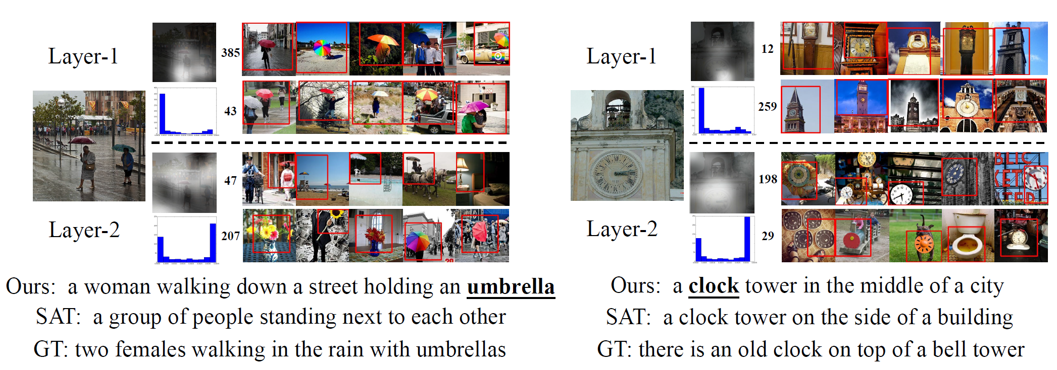
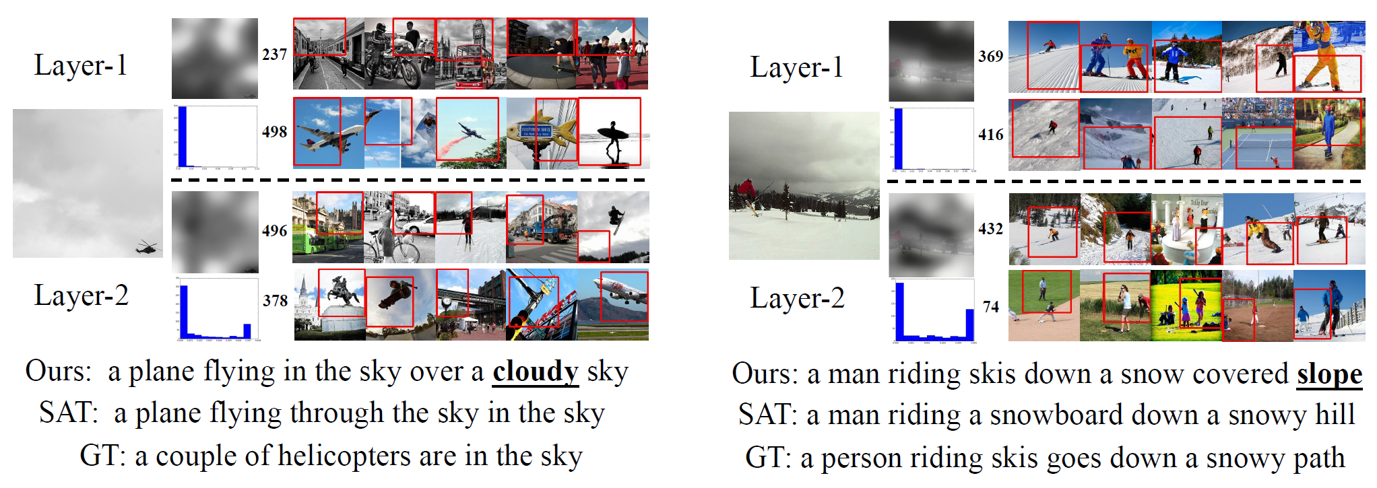
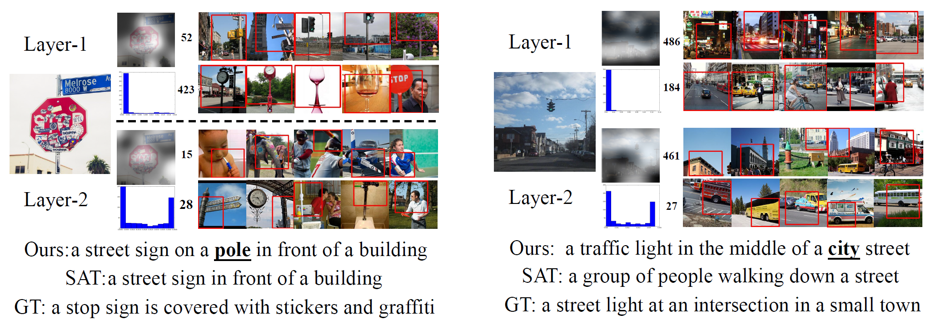
Image Understanding
Image to Caption

Slide 37
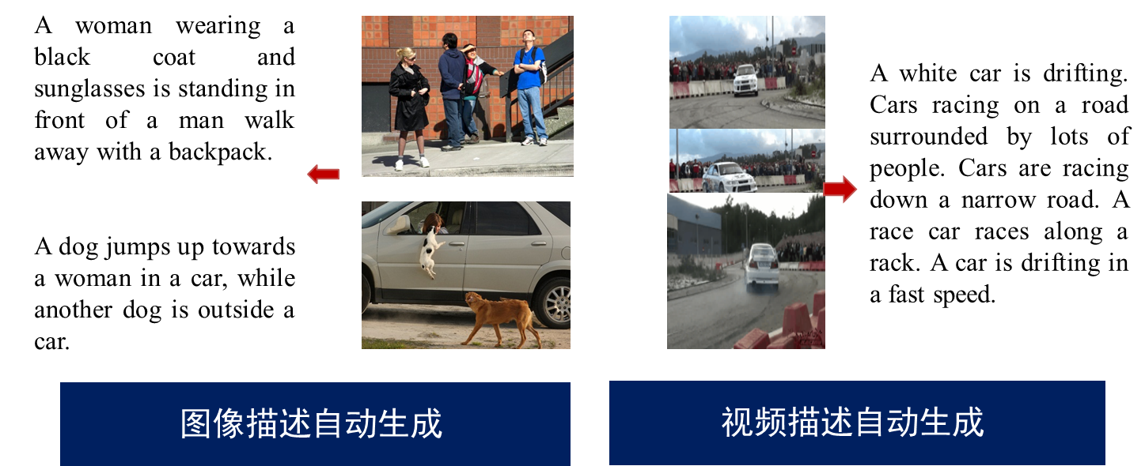
Multimodal: Language and Vision
Can AI translates between modals?

Slide 38
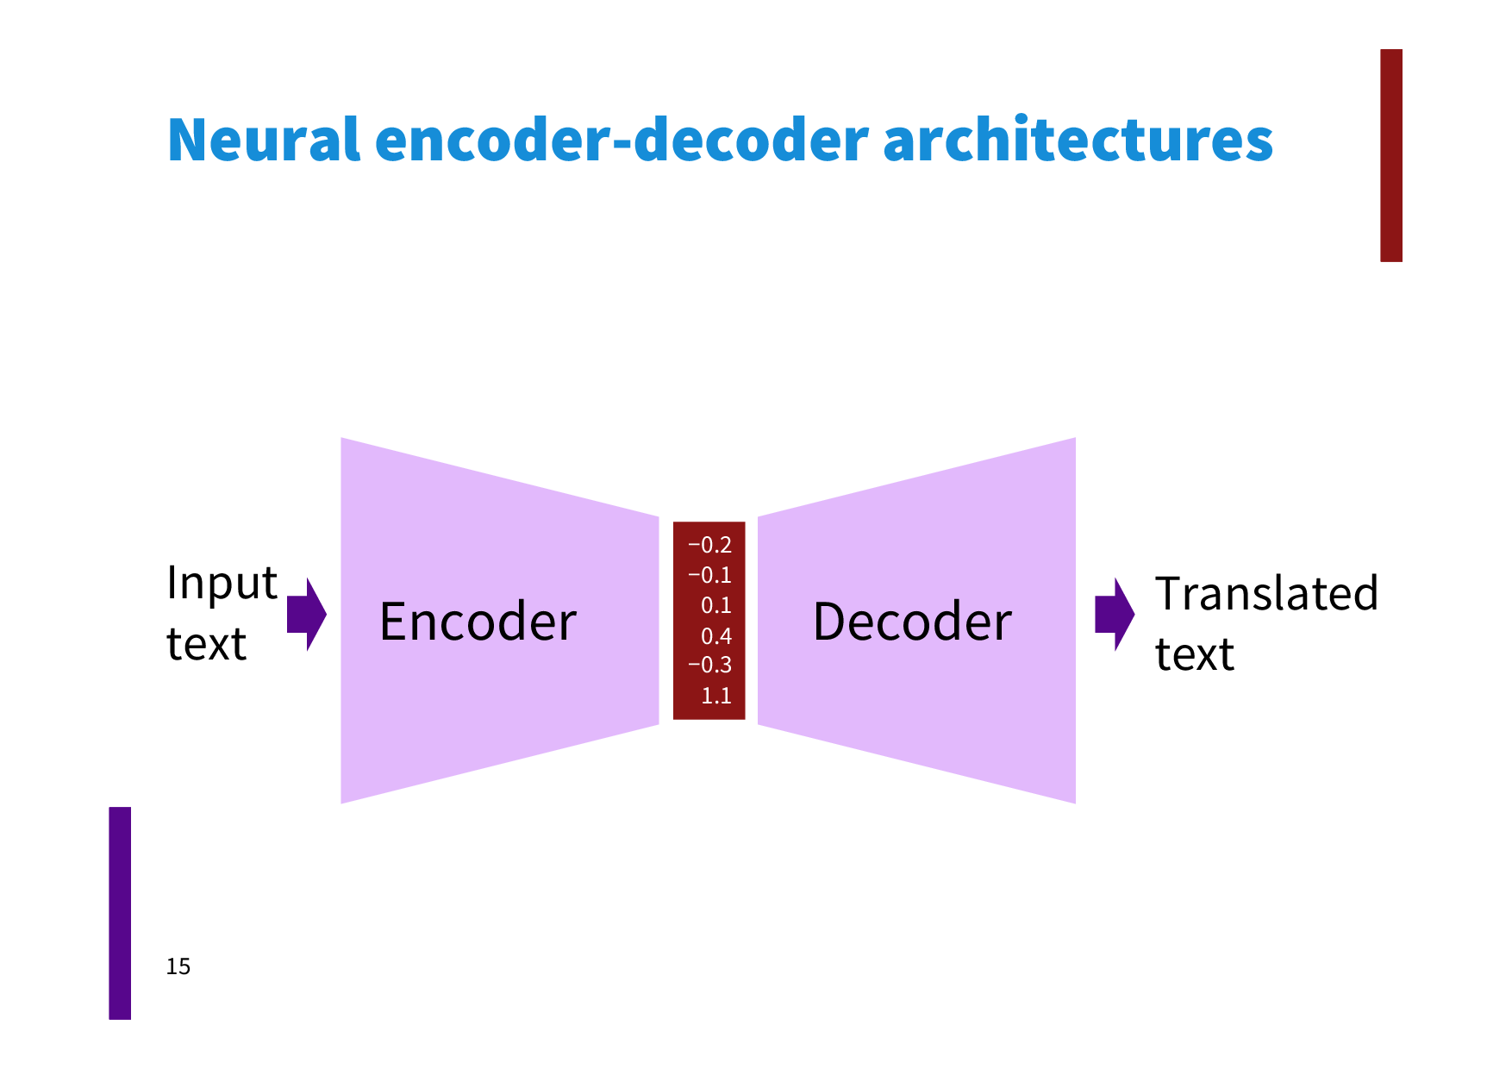
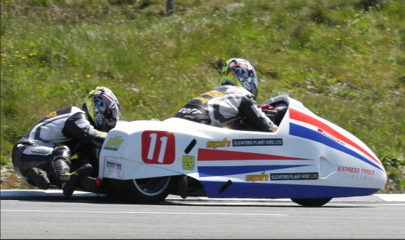
Multimodal: Language and Vision
Image to Caption
Image
句子
A man in street racer armor is examining the tire of another racers motor bike.
The two racers drove the white bike down the road.
Two motorists are riding along on their vehicle that is oddly designed and colored.
Two people are in a small race car driving by a green hill.
Two people in racing uniforms in a street car.
Deep Neural Networks
Flickr 8K dataset, JAIR 2013
Abstract Scenes dataset, CVPR 2013
Flickr 30K dataset, TACL 2014
COCO Captions dataset, 2015

Slide 39
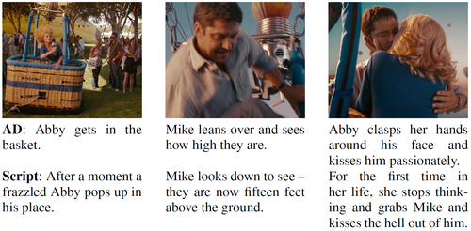
Multimodal: Language and Vision
Video to Caption
Video
段落
Deep Neural Networks
MPII Movie Description dataset, CVPR 2015
MSR-VTT dataset, CVPR 2016

Slide 40
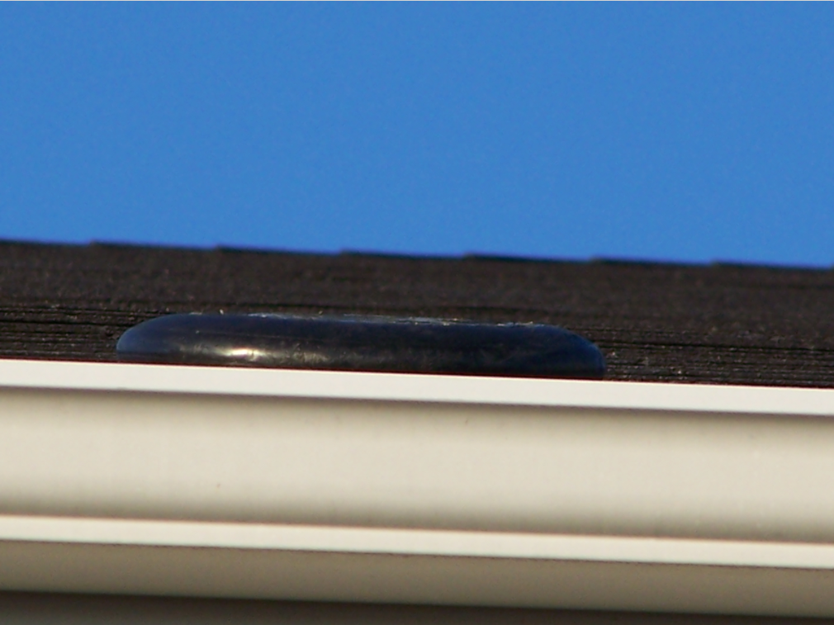
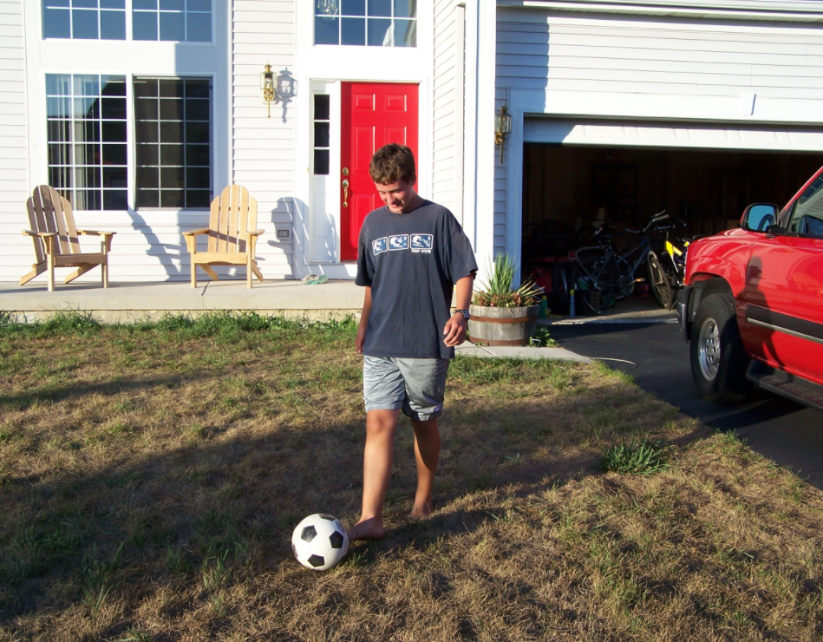
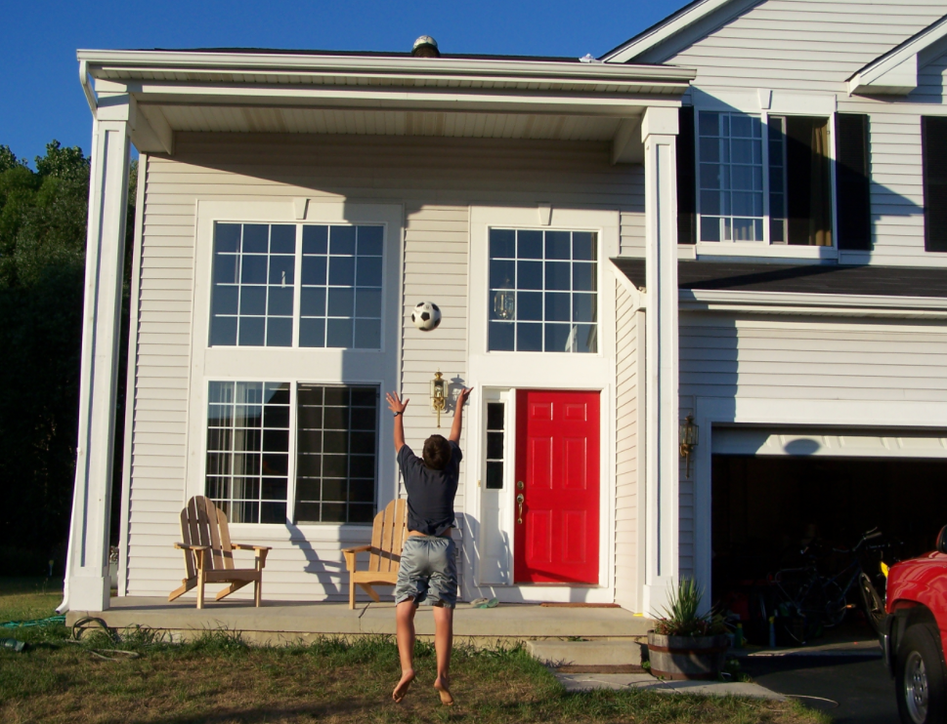
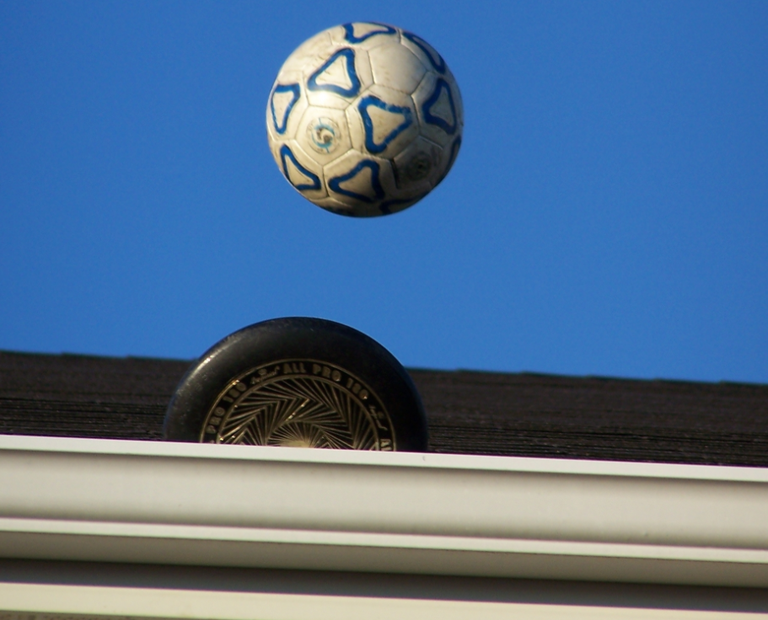
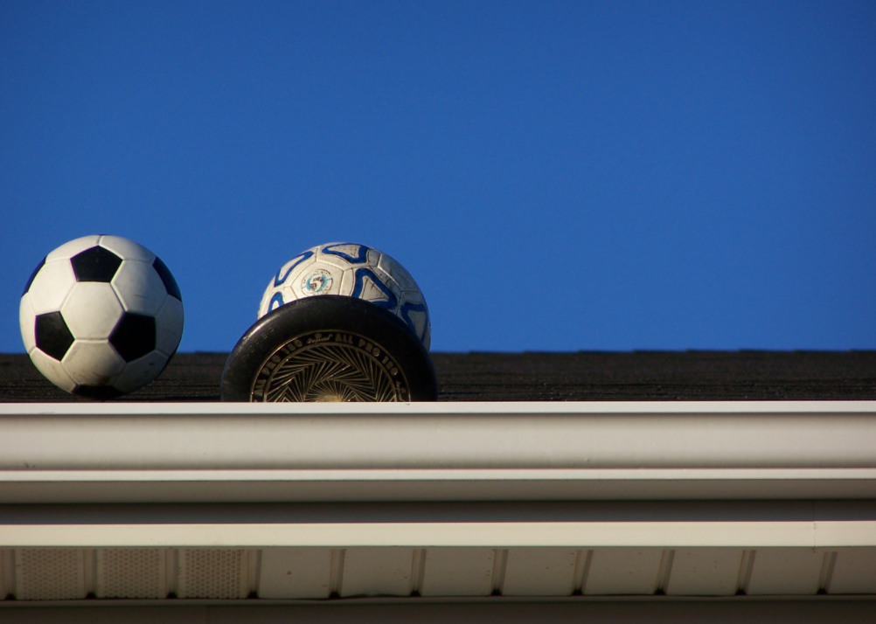
Multimodal: Language and Vision
Visual Image Storytelling
图像流
故事
图像流
图像流
A discus got stuck up on the roof.
Why not try getting it down with a soccer ball?
Up the soccer ball goes.
It didn't work so we tried a volley ball.
Now the discus, soccer ball, and volleyball are all stuck on the roof.
Deep Neural Networks
Visual Storytelling dataset, NAACL 2016

Slide 41
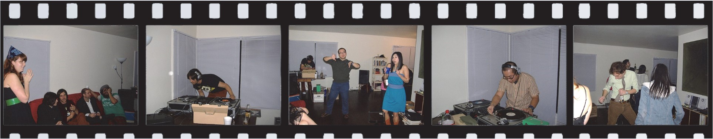
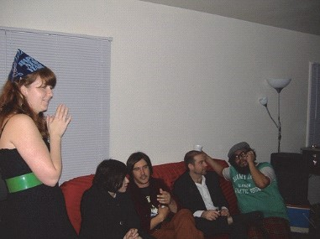








Multimodal: Language and Vision
挑战：图片视觉差异性大；包含物体复杂；文本摘要连贯性要求高
Not image/video to caption, but a visual storyteller
“
The house party yesterday was a big hit. There were some great DJs that were able to liven things up. The music they chose was good. Some of the DJs took turns. Everyone had a great time dancing.
Human Annotator
A group of people that are enjoying the night. A man with headphones standing in front of a double record player. The man and woman are standing up at a party. A young man wears headphones and plays with a turntable. A group of people are drinking and dancing at a party.
Concatenated Captions on Individual Photos
Hanqi Wang, Siliang Tang, Yin Zhang, Tao Mei, Yueting Zhuang, Fei Wu, Learning Deep Contextual Attention Network for Narrative Photo Stream Captioning, ACM MM 2017, Mountain View, CA USA, 2017

Slide 42

Multimodal: Language and Vision
Referring Expressions
图像
句子
位置
A girl wearing glasses and a pink shirt.
An Asian girl with a pink shirt eating at the table.
Deep Neural Networks
ReferItGame dataset, EMNLP 2014
Google RefExp dataset, CVPR 2016

Slide 43

Multimodal: Language and Vision
Image QA
图像
答案
问题
Black
Banana
Deep Neural Networks
VQA dataset, ICCV, 2015
VQA v2 dataset, CVPR 2017
CLEVR dataset, CVPR 2017

Slide 44


Multimodal: Language and Vision
Video QA
视频
答案
问题
His heart lights up
Deep Neural Networks
How does E.T. show his happiness that he is finally returning home?
Movie QA dataset, CVPR 2016

Slide 45

Multimodal: Language and Vision
Photo Stream QA
任务描述：给定一组叙事照片流，我们需要去理解视觉和文本信息并回答开放式的问题。
难点：
照片间的视觉差异大。
照片在时间维度上是离散的，及时间间隔差异大。
这两个难点进一步加大了，理解视觉信息并推理问题的难度

Slide 46


Multimodal: Language and Vision
Textbook QA
Kembhavi, A., Seo, M. J., Schwenk, D., Choi, J., Farhadi, A., & Hajishirzi, H. Are You Smarter Than a Sixth Grader? Textbook Question Answering for Multimodal Machine Comprehension. CVPR 2017.

Slide 47

计算机的“看”与“说”(对话)
Visual Dialog
图像
对话B
对话A
深度神经网络
VisDial dataset, CVPR 2017
GuessWhat?! dataset, CVPR 2017

Slide 48

Multimodal: Language and Vision
Embodied QA
Embodied Question Answering, Abhishek Das, Samyak Datta, Georgia Gkioxari, Stefan Lee, Devi Parikh, Dhruv Batra, CVPR 2018 (Oral)

Slide 49


Writing
Can AI creates poetries?

Slide 50

Writing
Can AI creates novels?
2016年初，用人工智能创作出来的短篇科幻小说《机器人写小说的那一天》通过了日本著名科幻文学奖“星新一奖”的初审，评委们的意见是：情节无破绽。
这部作品是由人类事先设定好登场人物、内容大纲等相当于文章“零部件”的内容后，人工智能再根据这些内容自动生成小说。
——还没有完全做到“无中生有”

Slide 51




Writing
Can AI creates news articles?

Slide 52


Writing
2019.5: OpenAI GPT-2
GPT-2 (a successor to GPT), was trained simply to predict the next word in 40GB of Internet text. Due to our concerns about malicious applications of the technology, we are not releasing the trained model…
在一项研究中，科学家们发现了一群独角兽，它们生活在安第斯山脉一个偏远的还没被开发山谷中，更令人惊讶的是这些独角兽会说一口流利的英语
因为它们独特的角，科学家们将他们命名为Ovid’s Unicorn，这些四角、银色角的独角兽是原来科学家所不曾见过的。
......中间还编写了，这些独角兽是如何被发现的，以及业内权威人士认为这些生物是如何出现的
最后还表明要验证这群独角兽是否为外星种族，唯一的方法可能就是通过DNA。
https://openai.com/blog/better-language-models/

Slide 53


Can AI create Arts?
draw sketches
Image style transfer

Slide 54

Image Generation

Slide 55


Image Generation
Generative Adversarial Networks (GAN)
https://www.youtube.com/watch?v=XOxxPcy5Gr4

Slide 56





Video Generation
2016 Face2Face
2017.4 CycleGAN
2017.11 DeepFakes

Slide 57


Video Generation
2018.8 Every Body Dance
2018.11 世界上第一位AI合成主播

Slide 58
从智能角度对人工智能的分类
领域人工智能
依葫芦画瓢、任务导向，如Deep Blue和AlphaGo
通用人工智能或跨领域人工智能
举一反三、从经验中学习，如“人类”智能
Traditional AI | Artificial General Intelligence
Focus on having knowledge and skills | Focus on acquiring knowledge and skills
Action acquiring via programing | Ability acquiring via learning
domain-specific ability via rule-based and exemplar-based | general ability via abstraction (intuition) and context (common sense)
Learning by data and rules | Learning to learn

Slide 59



从智能角度对人工智能的分类
混合增强人工智能
多种智能体的混合形式
人类智能+机器智能：如达芬奇外科手术机器人
人、机、物、网互联：如智慧城市系统
智慧城市与智能服务
Da Vinci手术机器人及其缝制葡萄皮

Slide 60
AI: the past and present
Mainstream methods that been used in AI History

Slide 61

1. Learning from Symbolic Rules
Symbolic AI
知识图谱
符号逻辑表示下的推理
用规则教

Slide 62

1. Learning from Symbolic Rules
IBM Waston
IBM Watson
David Ferrucci, et.al., Building Watson: An Overview of the DeepQA Project, AAAI 2010

Slide 63



2. Learning from Big Data
Data Driven AI
挖掘数据所蕴含的内在模式
用大数据学
（有监督）
Deep Visualization (ICML DL Workshop 2015)

Slide 64




2. Learning from Big Data

Slide 65


3. Learning from Experiences
Reinforcement Learning
从经验中的策略学习
Reinforcement Renaissance, Communications of the ACM, 2016,59(8):12-14
用问题引导
（反馈牵引）

Slide 66
Mainstream Methods in AI History
学习模式 | 优势 | 不足
用规则教 | 与人类逻辑推理相似，解释性强 | 难以构建完备的 知识规则库
用数据学 | 直接从数据中学 | 以深度学习为例：依赖于数据、解释性不强
用问题引导 | 从经验中进行能力的持续学习 | 非穷举式搜索 需更好策略
从数据到知识与能力，能力增强是最终目标
三种学习方法的综合利用值得关注！

Slide 67
Any Questions?

